Slide 1
Land Code Amendments
Building a Pathway to Home Ownership for ʼNa̱mǥis Members

Slide 2

Modernizing the ʼNa̱mǥis Land Code
Building a Foundation for Home Ownership
Purpose
To seek Council's support to move the proposed Land Code amendments to Member engagement and a Membership vote.

Slide 3
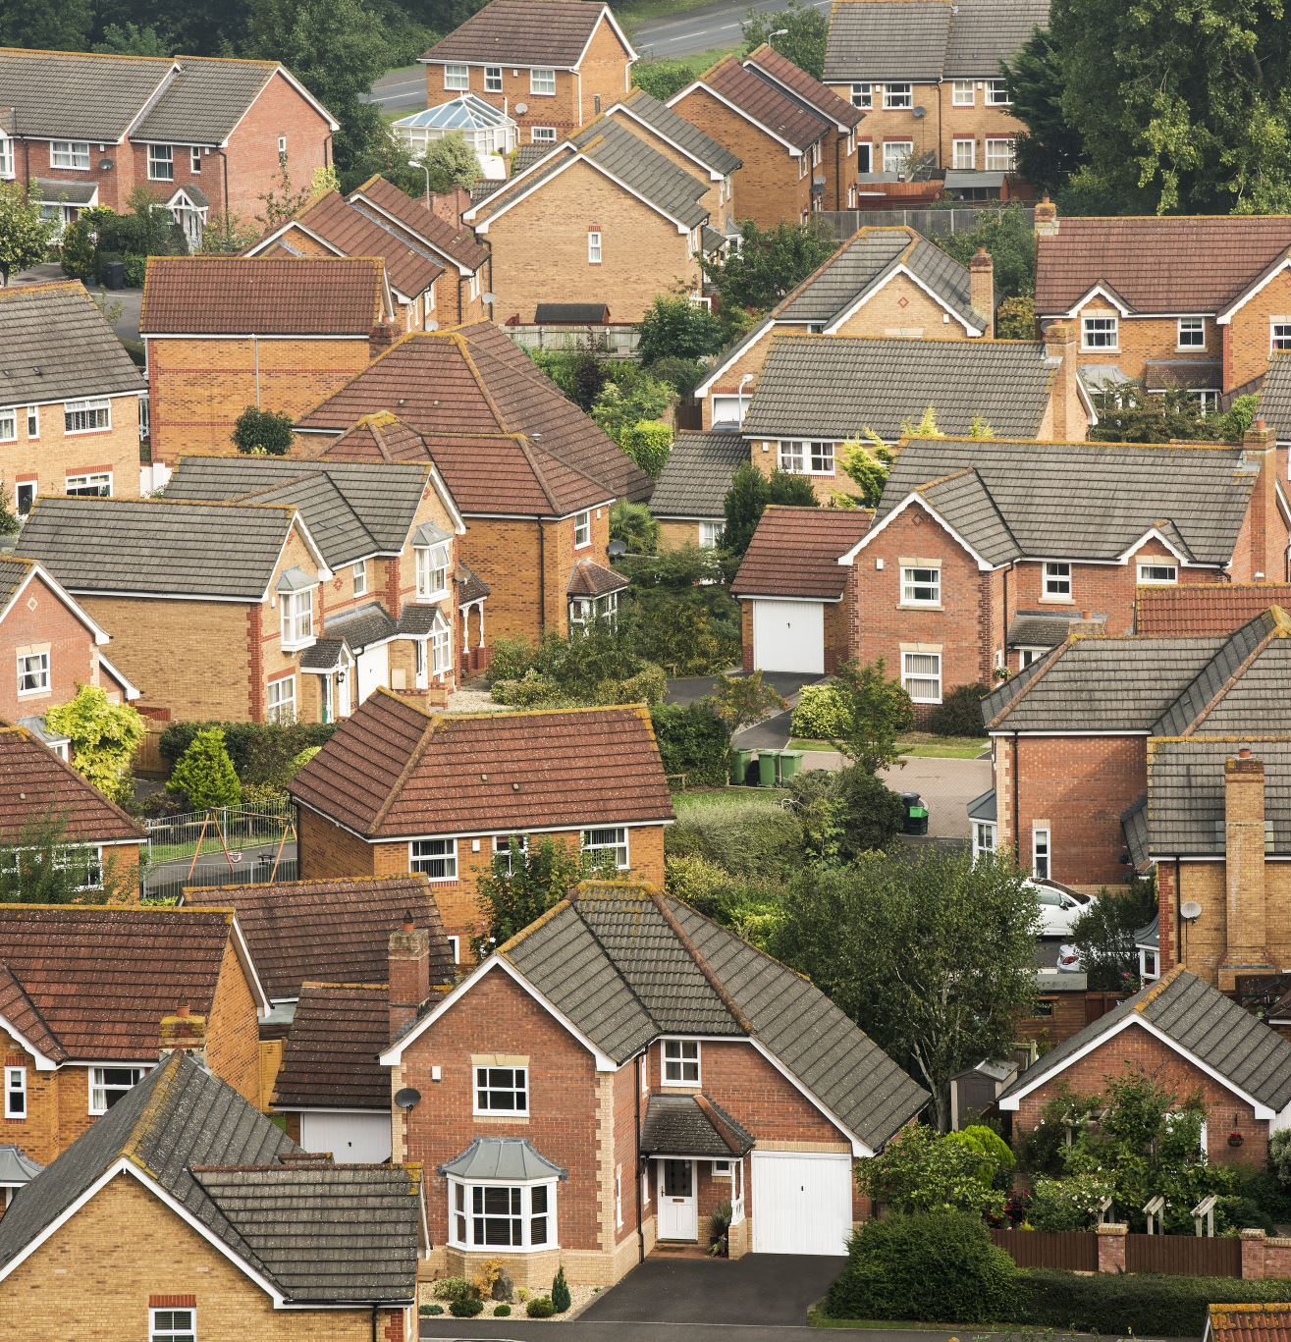
Why Are We Amending the Land Code?
The current Land Code has served us well...
But while developing the Allotment Law and Matrimonial Real Property Law, it became clear that the current Land Code contains barriers that limit our ability to:
• Support Member home ownership
• Enable private financing
• Modernize land administration
• Create flexible land laws
• Respond to future community needs
Bottom line:
The Land Code needs to evolve to support the future vision for housing and land governance. This framing is consistent with the work undertaken during the Allotment Law project and the recommendation to move to a new draft based on the Model Land Code.

Slide 4

Our Vision
More Housing Options for Members
The amendments create the legal foundation needed to support:
🏡 Home ownership
🏗 New home construction
🔨 Renovations
💰 Access to financing
👨‍👩‍👧 Multi-generational housing
🌿 Long-term community sustainability

Slide 5
Who Funded This Work?
First Nations Market Housing Fund (FNMHF)
A First Nations-led organization helping communities build pathways to home ownership.
FNMHF funded this project because communities need more than houses—they need the governance systems that make home ownership possible.
Funding supports:
✔ Land Code development
✔ Housing policies
✔ Land laws
✔ Governance capacity
✔ Member education
✔ Home ownership planning
Their vision is:
    First Nation Prosperity Through Homeownership

Slide 6
How Was the Draft Developed?
This was not drafted by one person.
The draft Land Code was developed through a collaborative process involving:
• Lands Management Advisory Committee (LMAC)
• Legal Counsel (Holly Vear Law)
• First Nations Land Management Resource Centre
• Lands Department
Over multiple meetings, LMAC:
✔ Reviewed the Model Land Code
✔ Discussed community priorities
✔ Identified required policy changes
✔ Provided direction to legal counsel
✔ Reviewed multiple draft versions
✔ Recommended the current draft proceed to Council for review

Slide 7
Why Doesn't the Current Land Code Work?
Current Land Code
❌ Certificate of Home Ownership does not create a legal interest in land
❌ Limited financing options
❌ Difficult to update
❌ Too much procedure in the Land Code itself
❌ Future changes require more Land Code amendments
Proposed Land Code
✔ Modern allotment framework
✔ Better supports financing
✔ Flexible framework
✔ Procedures move into Land Laws
✔ Easier to adapt over time

Slide 8
What Are the Biggest Changes?
The new Land Code will:
✔ Modernize land governance
✔ Introduce a flexible framework
✔ Support future home ownership
✔ Reduce unnecessary Land Code amendments
✔ Keep major land decisions with Members
✔ Move operational details into Land Laws

Slide 9
What Happens Next?
Council Review
Member Engagement
Final Draft
Membership Vote
Land Code Enacted
Allotment Law
MRP Law
Housing Policy
Home Ownership Program

Slide 10
What Are We Asking Council Today?
Administration is requesting Council's support to:
✔ Review the Draft Land Code
✔ Provide direction, if required
✔ Authorize Member engagement
✔ Move toward a Membership vote (target: next AGM)

